Slide 1
Meeting # 2
September 16, 2021
Michael Lee

Slide 2
Deliverables
Install python, dash
Run open-source app locally from plotly gallery
Use presentation template to show results

Slide 3
Methodology and Learnings
How did I do it?
-Python official website
-Pycharm IDE
-pip install dash
-git
What did I learn on the way?
-refresher on command-line
-change Windows policy to run scripts
-create and activate a virtual environment
-install requirements

Slide 4
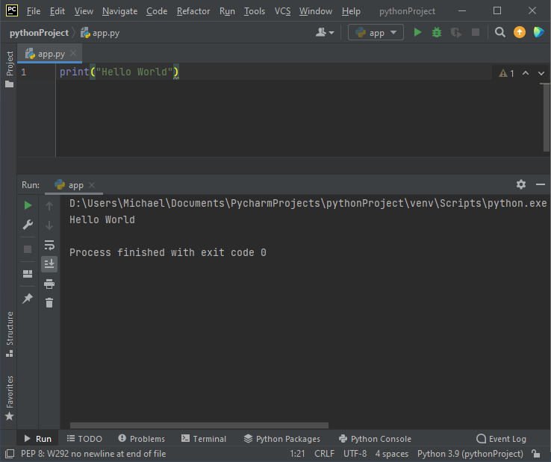
Results

Slide 5
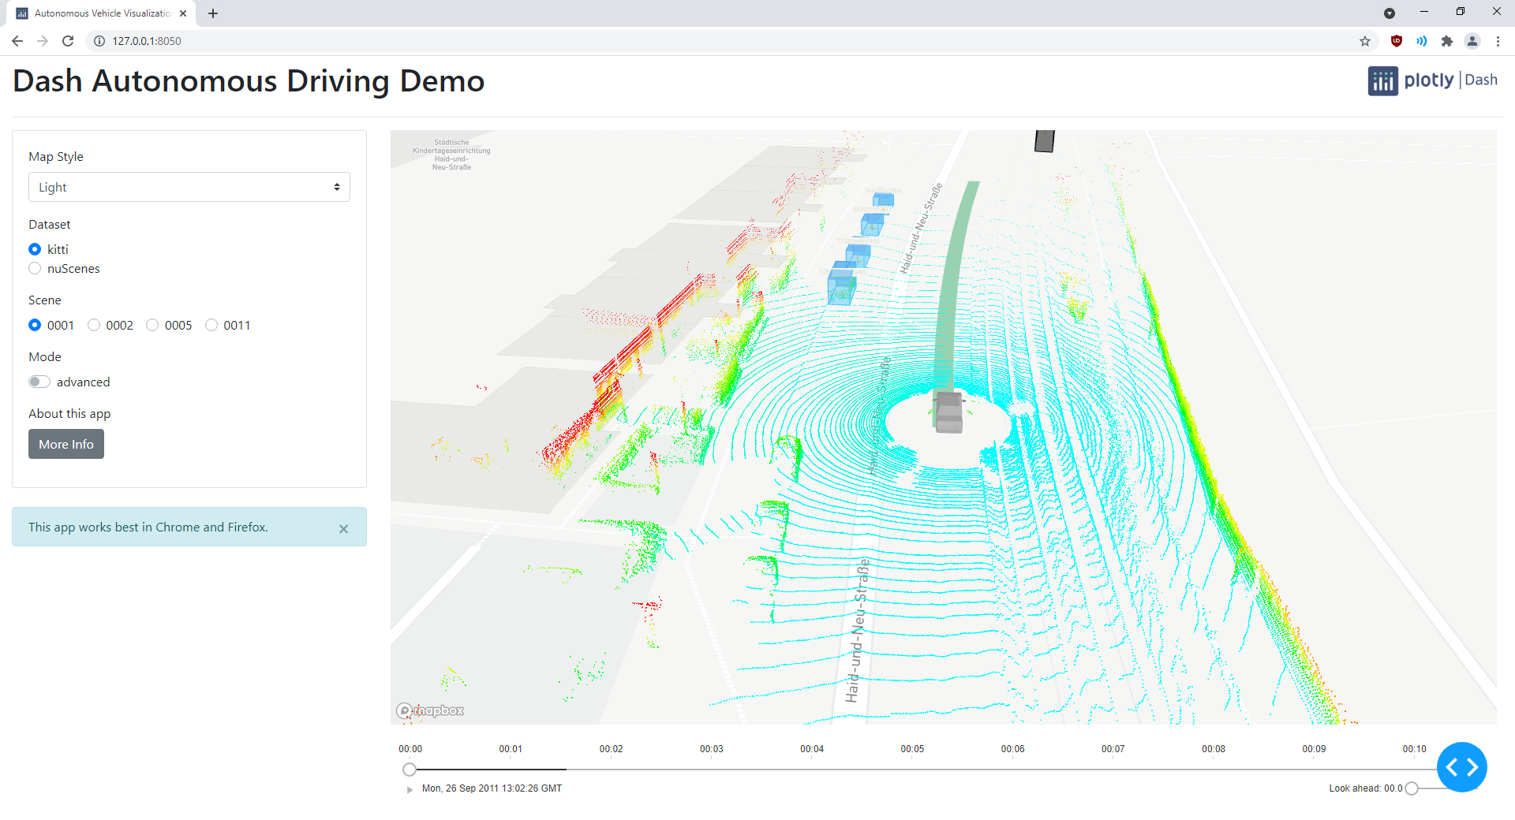
Results

